Slide 1

Student Result Management Website
Mini project 3CSE-4 Team:D-10

Slide 2
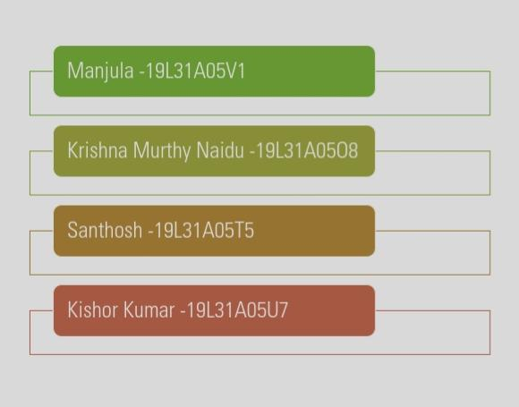
Team Members

Slide 3

Abstract
Student Result Management system using Nodejs ,EJS, HTML,CSS,MongoDB is a web based application. Student Result Management system stores the student detail and their student results.
By using this website a student can able to get their results online with complete details.
In this website admin can add student details, subject wise marks , add new student details.
For the student side student can open the website and in student login after entering valid roll id, password can able to get their results.

Slide 4
Features
Student Result Management System divided in two modules:
Admin Dashboard
Admin can add/update/delete Class.
Admin can add/update/delete Students.
Admin can register new student and also edit info of the student
Admin can add/edit/delete the notice.
Admin can change own password
Admin can see all the students details.
Students:
Student can search their result using valid rollid.
Student can also view the notices.

Slide 5
Technologies Used
Front end –HTML,EJS,CSS
Back end- MongoDB,Nodejs,Javascript.
Npm packages: Express Nodemon Body-parser Ejs Mongoose
Front end
Back end
Npm packages

Slide 6

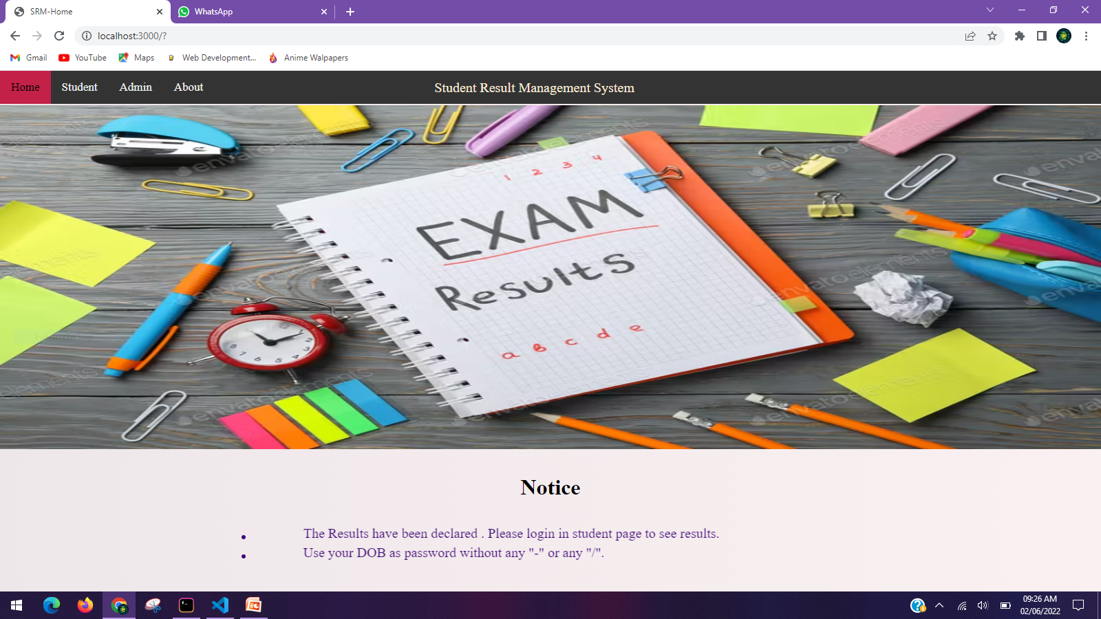
Home page

Slide 7

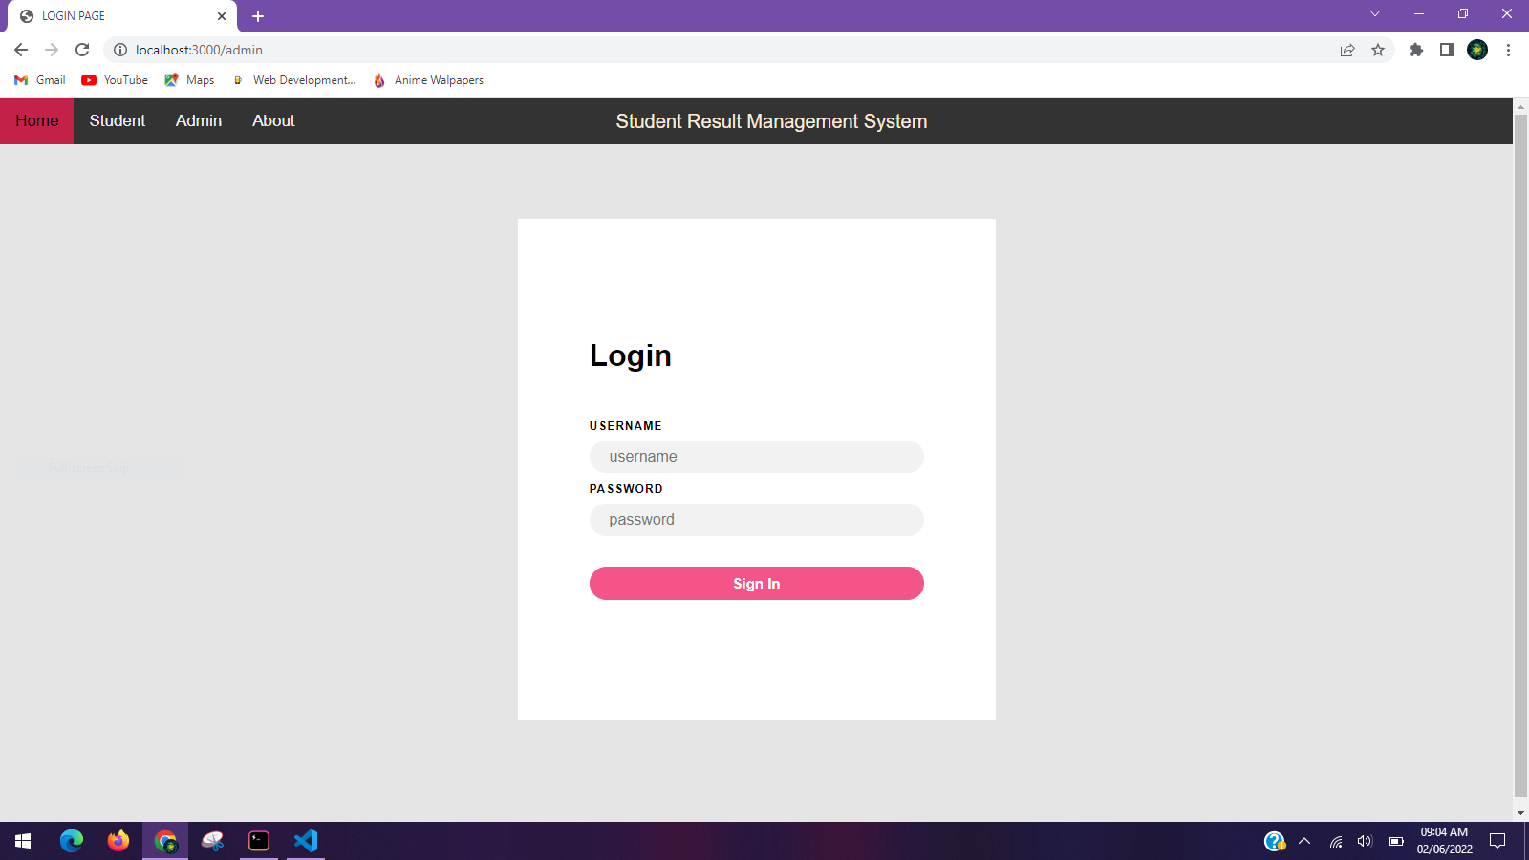
Admin Login

Slide 8

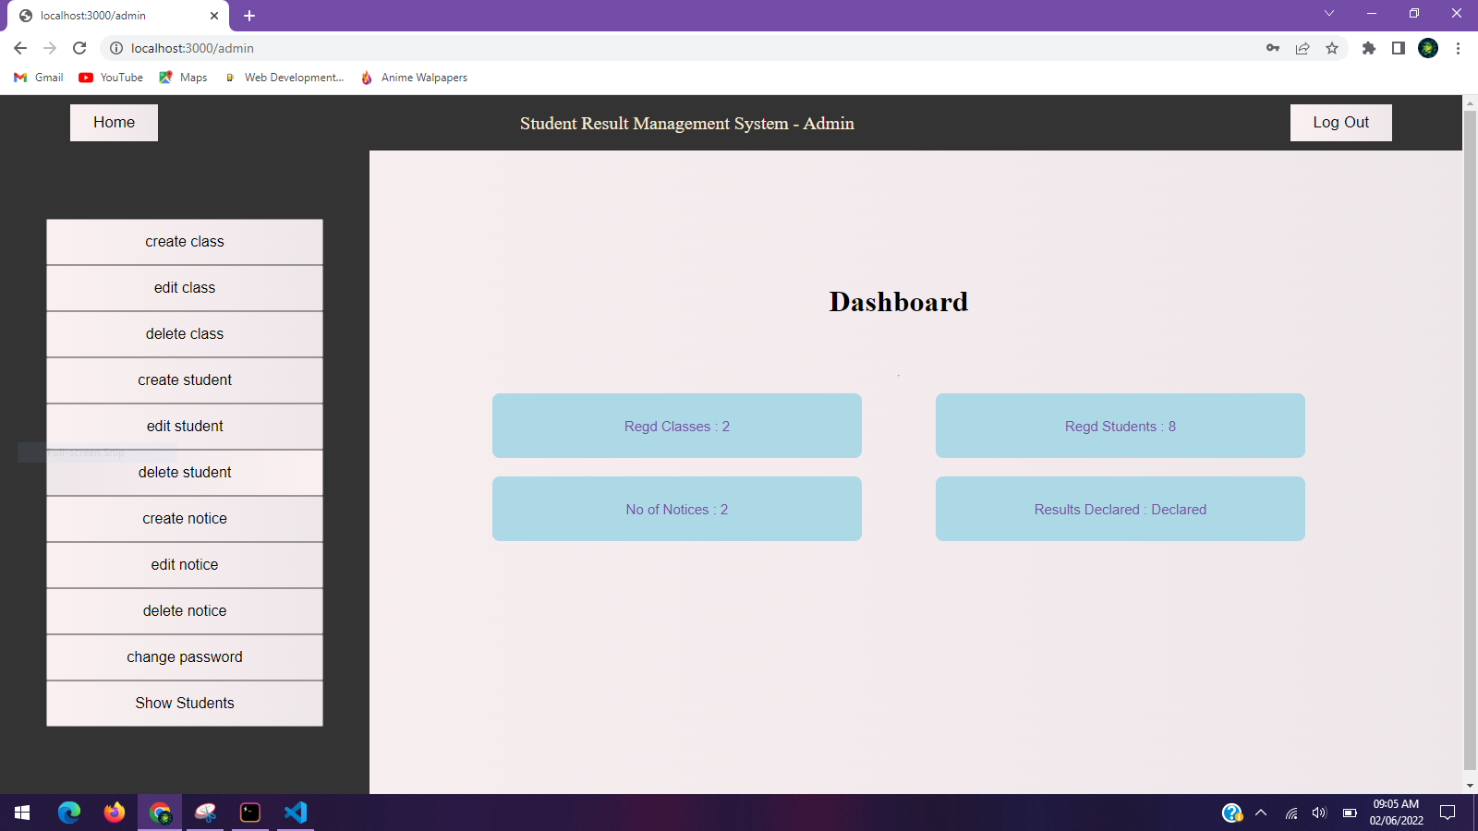
Admin page

Slide 9

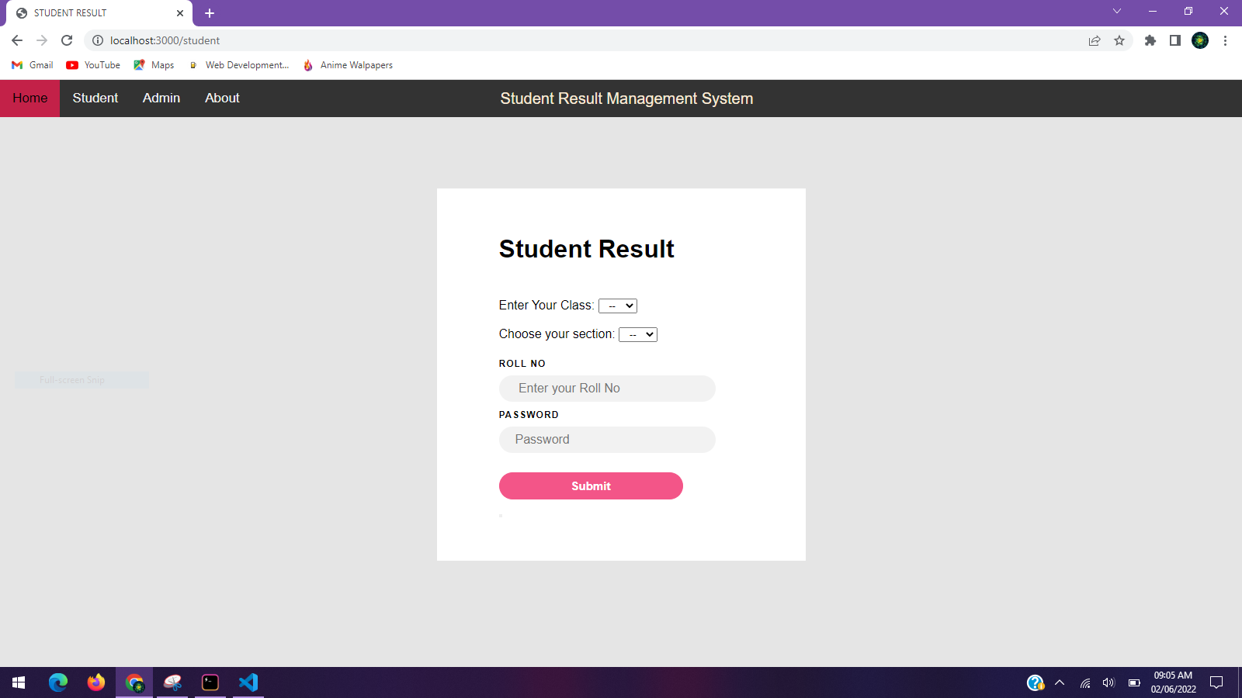
Student Login

Slide 10
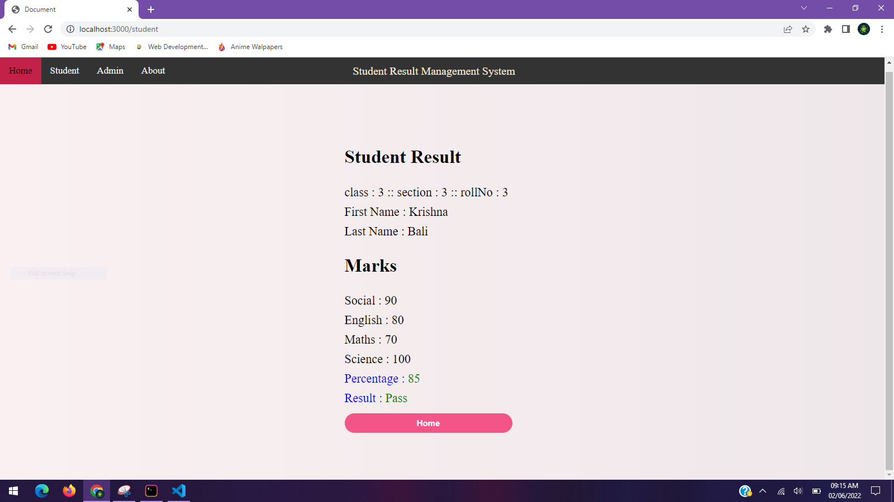
Student Result

Slide 11

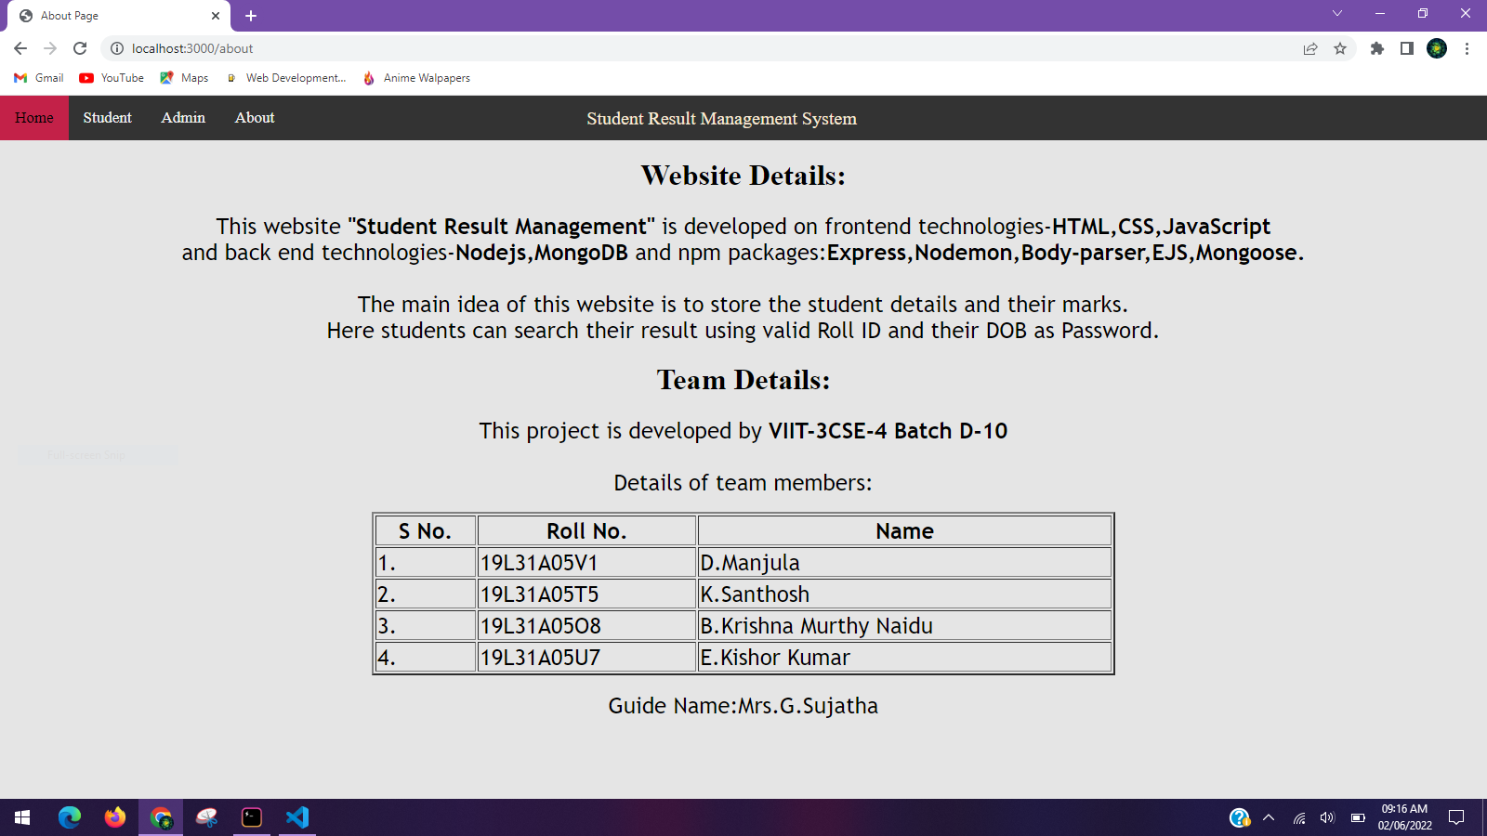
About Page

Slide 12

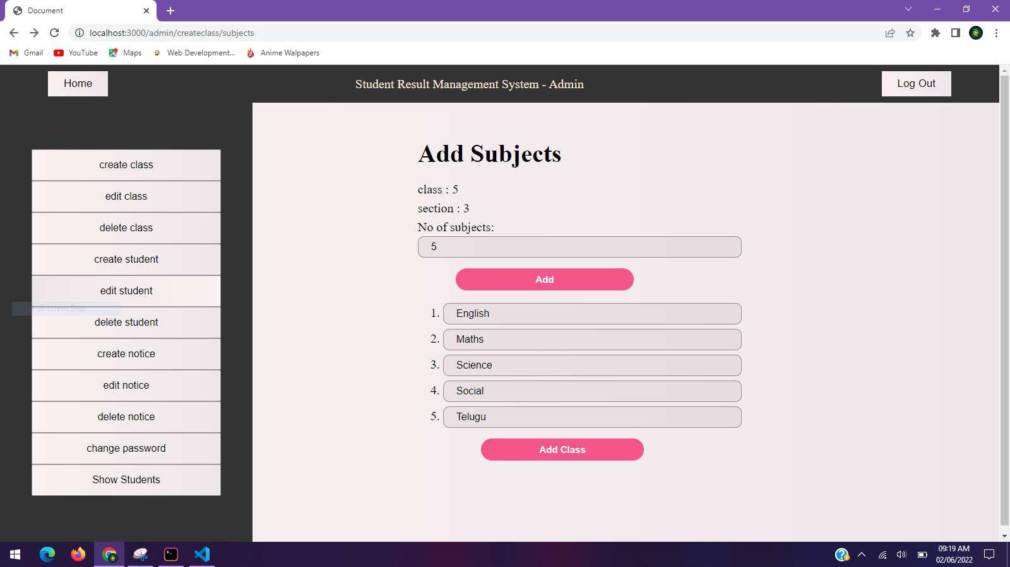
Create Class

Slide 13

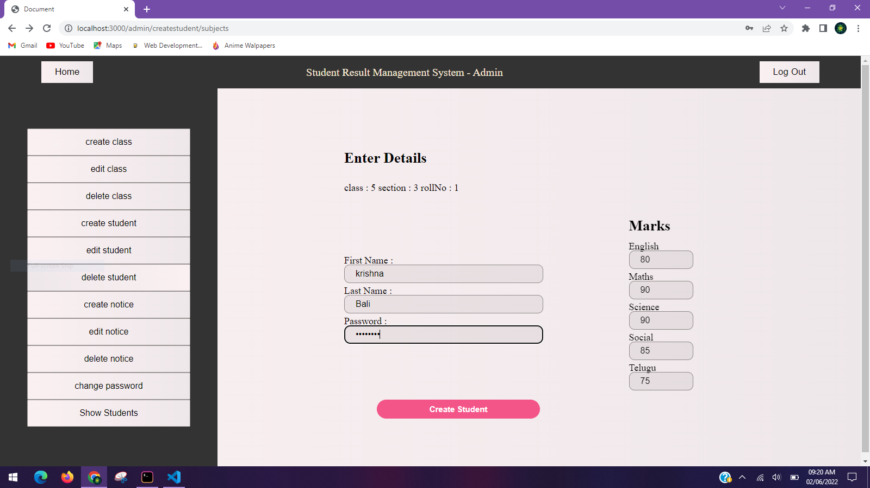
Create Student

Slide 14
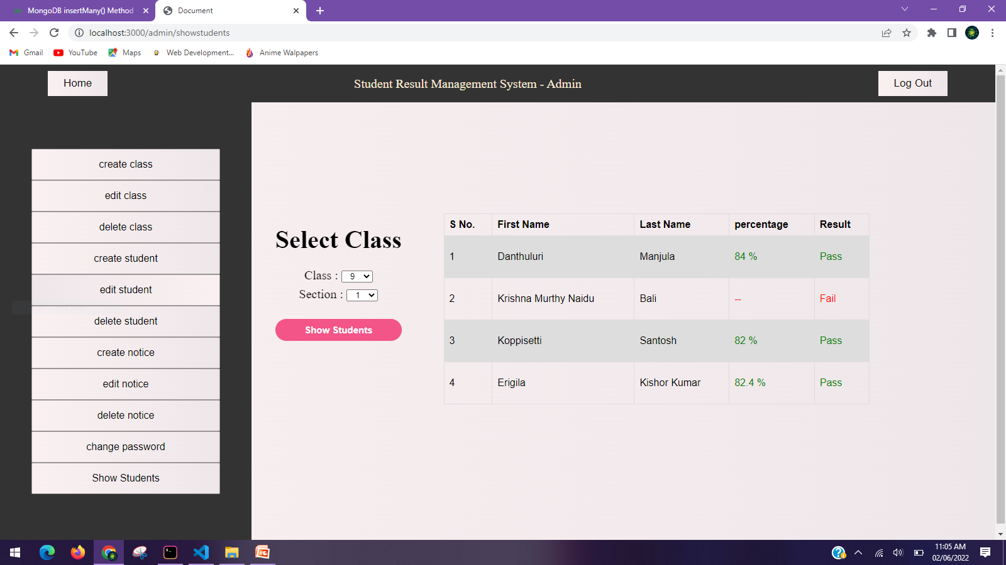
Students Details

Slide 15
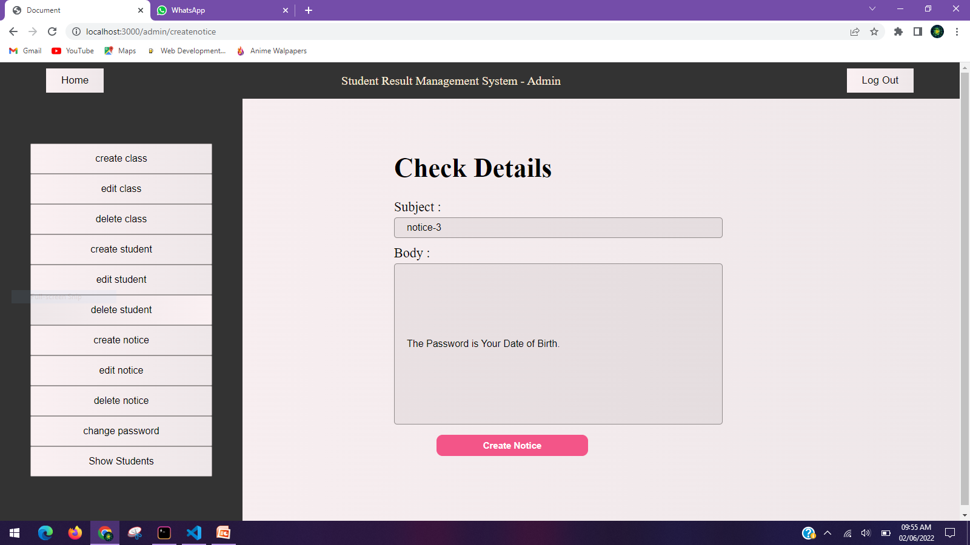
Create Notice

Slide 16
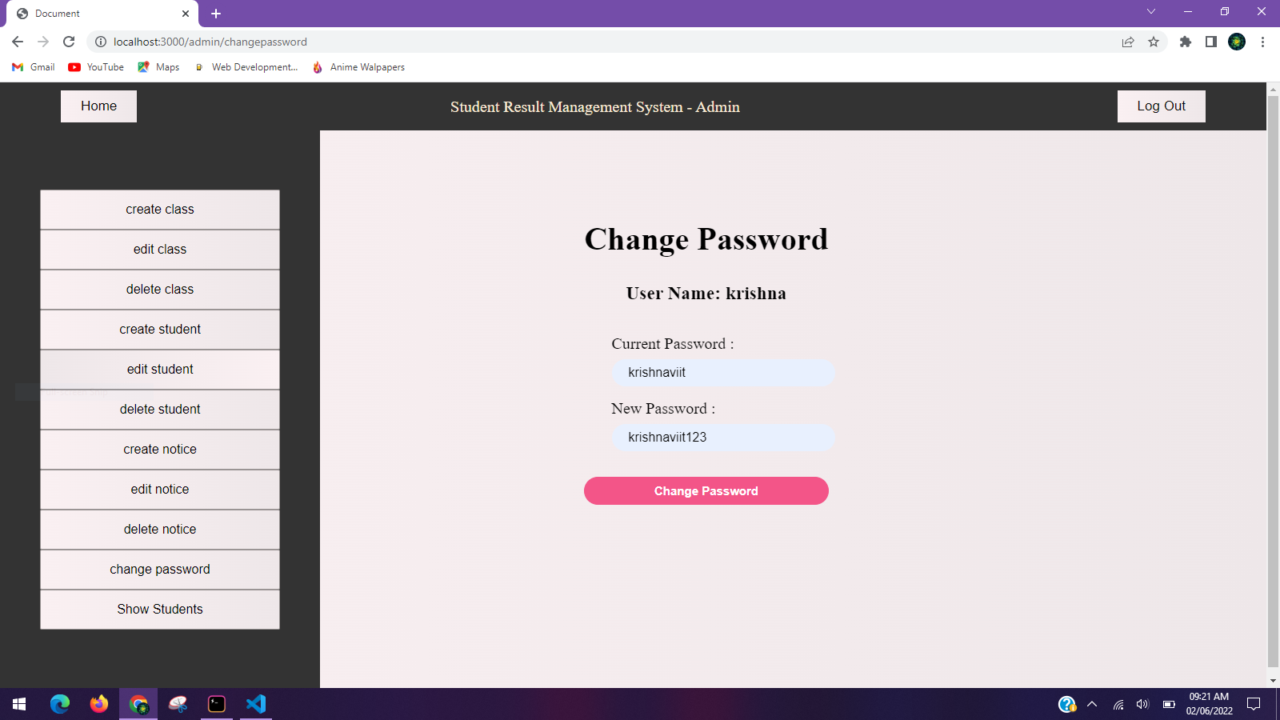
Change Password

Slide 17
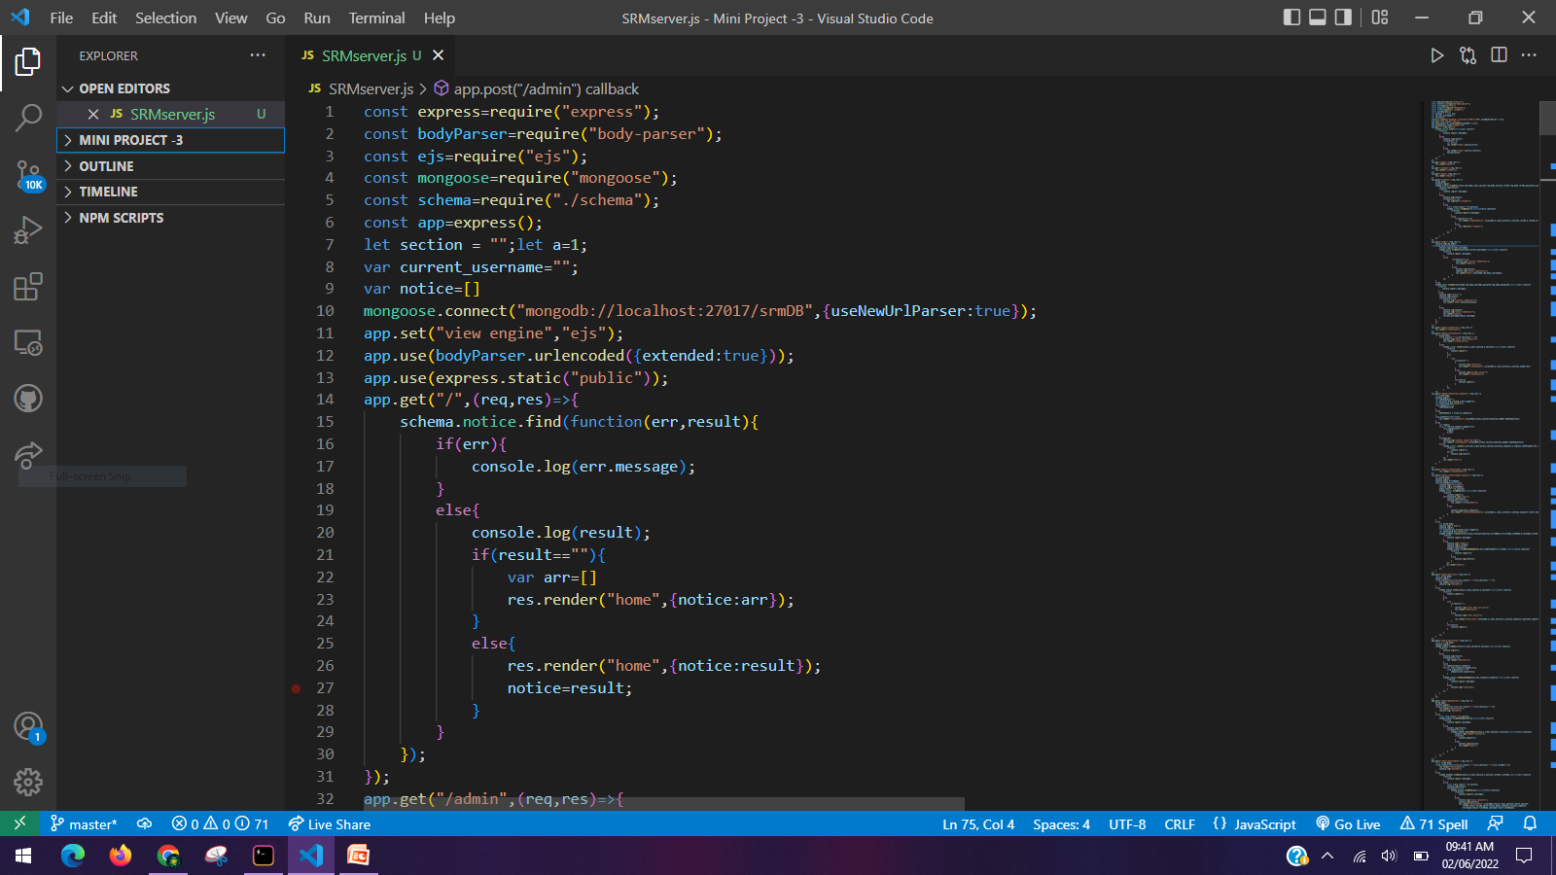
Backend Server code

Slide 18
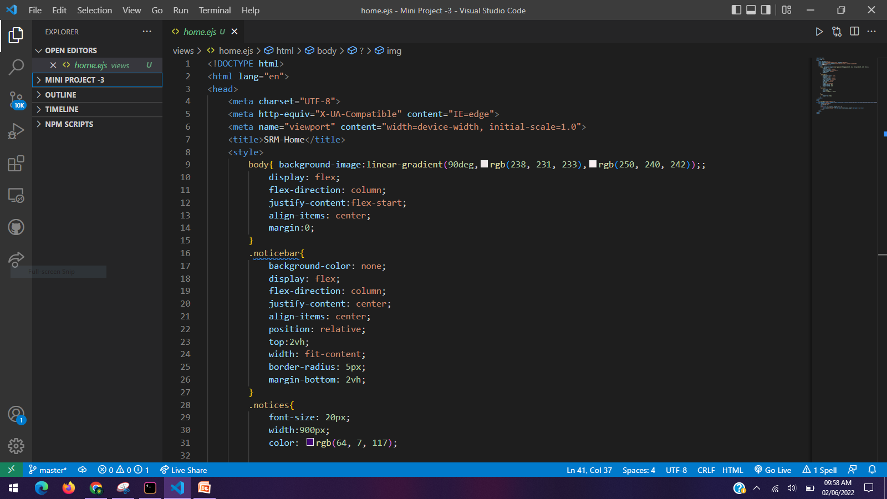
Frontend Home page code

Slide 19
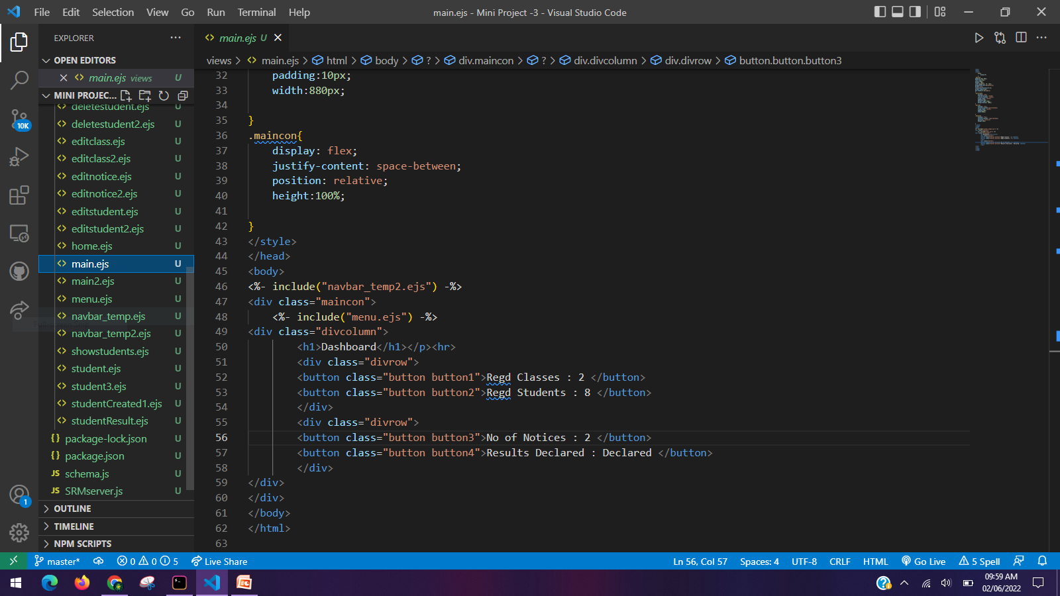
Frontend Admin page code

Slide 20
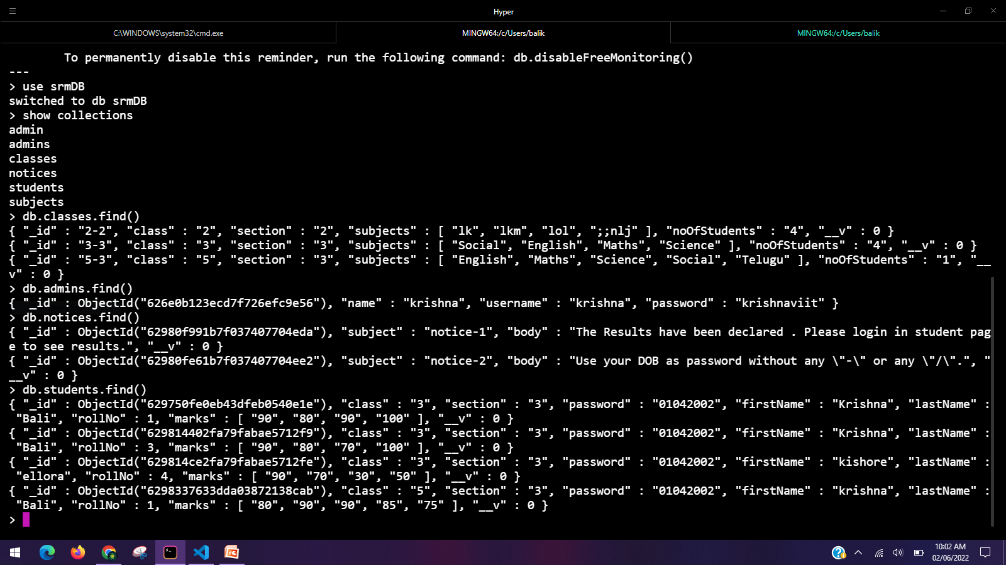
MongoDB Operations

Slide 21

Thank you

